Slide 1


CITS1003 Introduction to Cybersecurity [2] Cryptography Exercises
Dr Garrison Gao

Slide 2
Outline
Crack the code
Key space
Sharing secrets
Possible questions

Slide 3
Crack the code
nbcm cm u nij mywlyn gymmuay nbun sio uly lykoclyx ni xywixy ch ilxyl ni mifpy nby jlivfyg myn ion ni sio ch zlihn. biqypyl sio uly qyfwigy ni omy pulciom lymiolwym ni byfj sio mifpy nbcm jlivfyg, qbcwb sio gus zchx omyzof von cn myygm nbun nbcm mcgjfy jlivfyg wiofx vy mifpyx yumcfs vs omcha migy uonigunyx niifm mowb um wsvylwbyz.
Find live lectures from here: https://github.com/uwacyber/cits1003/tree/2022s1/cits1003-lecture_slides
For week 2: CITS1003-2 Cryptography-exercises

Slide 4
Crack the code
How did you do it?

Slide 5
Crack the code
Boxentriq Cryptogram auto solver: https://www.boxentriq.com/code-breaking/substitution-cipher

Slide 6
Crack the code
CyberChef : https://gchq.github.io/CyberChef/
nbcm cm u nij mywlyn gymmuay nbun sio uly lykoclyx ni xywixy ch ilxyl ni mifpy nby jlivfyg myn ion ni sio ch zlihn. biqypyl sio uly qyfwigy ni omy pulciom lymiolwym ni byfj sio mifpy nbcm jlivfyg, qbcwb sio gus zchx omyzof von cn myygm nbun nbcm mcgjfy jlivfyg wiofx vy mifpyx yumcfs vs omcha migy uonigunyx niifm mowb um wsvylwbyz.

Slide 7
Crack the code
How did you do it?
Will your approach work for other encoded messages? Why or why not?

Slide 8
Crack the code
You are given a ciphertext as follows:
ymnx nx ymj gjxy xjsyjshj jajw
Applying cryptanalysis, what is the likely letter for “e”, “t” and “a” (the top 3 most frequent letters)?

Slide 9
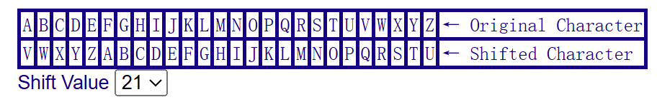
Crack the code
We have the frequency as follows (sorted):
Plaintext: this is the best sentence ever
So “j” mapped to “e”, and “y” to “t”
j : 7
y : 4
x : 4
m : 2
n : 2
s : 2
g : 1
h : 1
a : 1
w : 1

Slide 10
Crack the code
Frequency auto-analysis: https://www.dcode.fr/frequency-analysis

Slide 11
Crack the code
This works because?

Slide 12
Crack the code
This works because?
This might not work because?

Slide 13
Key space
Caesar Cipher
Polyalphabetic cipher (e.g., Vigenere)
Monoalphabetic cipher
DES
3DES
AES

Slide 14
Key space
Caesar Cipher:

Slide 15
Key space
Caesar Cipher
right-shift plaintext with 1 position
A → B
right-shift plaintext with 27 positions
A → B
right-shift plaintext with 2 positions
A → C
right-shift plaintext with 26 positions
A → A

Slide 16
Key space
Caesar Cipher: 26

Slide 17
Key space
Polyalphabetic cipher (e.g., Vigenere):
Plaintext | H | A | C | K | I | N | G | I | S | F | U | N
Code | 7 | 0 | 2 | 10 | 8 | 13 | 6 | 8 | 18 | 5 | 20 | 13
Key | C | A | T | S | C | A | T | S | C | A | T | S
Shift | 2 | 0 | 19 | 18 | 2 | 0 | 19 | 18 | 2 | 0 | 19 | 18
Ciphertext | J | A | V | C | K | N | Z | A | U | F | N | F

Slide 18
Key space
For “A”, there are 26 options.
For “B”, there are 26 options.
…
For “Z”, there are 26 options.
Polyalphabetic cipher (e.g., Vigenere)
key size: n letters in total
key space: 26^n

Slide 19
Key space
Monoalphabetic cipher
Plaintext letter to ciphertext letter map is one-to-one

Slide 20
Key space
Monoalphabetic cipher:
For “A”, there are 26 options.
For “B”, there are 25 options.
…
For “Z”, there is 1 option.
Plaintext letter to ciphertext letter map is one-to-one
key space: 26!

Slide 21
Key space
Polyalphabetic cipher (e.g., Vigenere): multiple alphabet for substitution
26^n
Monoalphabetic cipher: single alphabet for substitution
26!

Slide 22
Key space
DES:

Slide 23
Key space
DES: 2^56

Slide 24
Key space
Double DES:
K1
K2
Encryption
Encryption
P
C
K2
K1
Decryption
Decryption
C
P

Slide 25
Key space
Double DES: Meet-in-the-Middle-Attack, Knowling a pair of (p1, c1)
Encrypt
p1
Kp | Output
Kp1 | A
Kp2 | G
Kp3 | Y
… | M
… | E
Kp2^56 | N
Kp

Slide 26
Key space
Double DES: Meet-in-the-Middle-Attack, Knowling a pair of (p1, c1)
Encrypt
Decrypt
p1
c1
Kp | Output
Kp1 | A
Kp2 | G
Kp3 | Y
… | M
… | E
Kp2^56 | N
Kp | Output
Kc1 | T
Kc2 | Y
Kc3 | O
… | J
… | L
Kc2^56 | P
Kp
Kc

Slide 27
Key space
Double DES: Meet-in-the-Middle-Attack, Knowling a pair of (p1, c1)
Encrypt
Y
Decrypt
p1
c1
Y
Kp | Output
Kp1 | A
Kp2 | G
Kp3 | Y
… | M
… | E
Kp2^56 | N
Kp | Output
Kc1 | T
Kc2 | Y
Kc3 | O
… | J
… | L
Kc2^56 | P
Kp
Kc
Brute-force complexity: 2*2^56

Slide 28
Key space
Tripple DES:
K1
K2
K3
Encryption
Decryption
Encryption
P
C

Slide 29
Key space
Tripple DES:
K1
K2
K3
Encryption
Decryption
Encryption
P
C
Mode | Key Space
K1=K2=K3 | 2^56
K1=K3, K2 | 2^112
K1, K2, K3 | 2^168

Slide 30
Key space
AES

Slide 31
Key space
AES: 2^128, 2^192 or 2^256

Slide 32
Sharing secrets
Our symmetric key cipher systems are fast and secure.
But how do we make sure the key is shared between the two parties securely?
Answer: Asymmetric key cipher – public key cryptography (PKC), e.g., RSA.
But how to use PKC for secrets sharing?

Slide 33





share a key
Bob’s public key
Insecure Internet
Bob’s private key
a shared key
encrypted
a shared key
Alice
Bob

Slide 34

share a key
Bob’s public key
Insecure Internet
Bob’s private key
a shared key
encrypted key
a shared key
Alice
Bob
encrypted key
a shared key

Slide 35
Non-Repudiation
To prove that Alice was the one that sent the message
Alice encrypts the document with her private key and Bob decrypts it with Alice’s public key
It must be Alice because only she would have her private key
This also authenticates Alice
In practice, we don’t need to encrypt the entire document but can do a hash of the document

Slide 36





Non-Repudiation
Alice
Alice’s Private Key
Alice’s Public Key
Bob
Encryption
Decryption
Plaintext
Ciphertext
Plaintext

Slide 37
Confidentiality and Authentication
Combine the two processes
Alice encrypts the document with her private key
Alice then encrypts again with Bob’s public key
Bob decrypts the document with Bob’s private key
Bob decrypts the document with Alice’s public key

Slide 38
Possible questions
Easy
Why do we salt passwords before hashing them?
Are hash functions secure?
Your Diffie-Hellman key exchange didn’t work, what went wrong?

Slide 39
Possible questions
Easy
Why do we salt passwords before hashing them?
Algorithm that maps data of arbitrary size to a bit string of a fixed size
Designed to operate only one way (can’t be inverted)
Properties:
deterministic - the same message results in the same hash
fast to compute
very difficult to generate a message from its hash
small changes to message result in large changes to hash
two different messages are very unlikely to generate the same hash
MD5 was invented by Ron Rivest in 1992 and very common but proved flawed
SHA-2 recommended now although it comes from the NSA – can output various sizes of hash (224, 256, 384 and 512 bits)
SHA-3 released by NIST in 2015

Slide 40
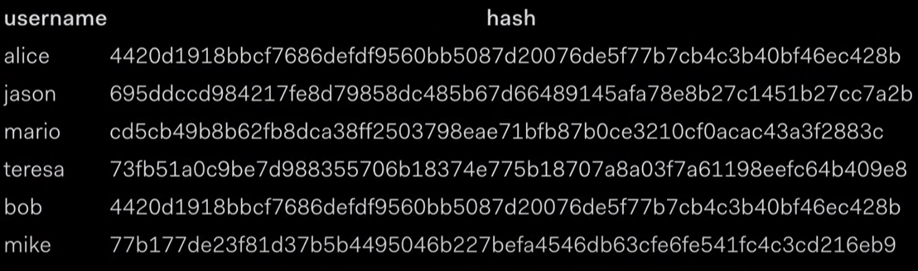
Possible questions
Easy
Why do we salt passwords before hashing them?

Slide 41
Possible questions
Easy
Why do we salt passwords before hashing them?
Are hash functions secure?

Slide 42
Possible questions
Easy
Why do we salt passwords before hashing them?
Are hash functions secure?

Slide 43
Possible questions
Easy
Why do we salt passwords before hashing them?
Are hash functions secure?
Your Diffie-Hellman key exchange didn’t work, what went wrong?

Slide 44
Possible questions
Easy
Why do we salt passwords before hashing them?
Are hash functions secure?
Your Diffie-Hellman key exchange didn’t work, what went wrong? (Man-in-the-Middle Attack)
Eve
Alice
Bob

Slide 45
Possible questions
Easy
Why do we salt passwords before hashing them?
Are hash functions secure?
Your Diffie-Hellman key exchange didn’t work, what went wrong?
What are differences between Diffie-Hellman and RSA?
https://www.youtube.com/watch?v=85oMrKd8afY (Diffie-Hellman Explained)
https://www.youtube.com/watch?v=wcbH4t5SJpg (RSA explained)
https://www.geeksforgeeks.org/computer-networks/difference-between-diffie-hellman-and-rsa/ (Differences)

Slide 46
Possible questions
Medium - hard
In what scenario is it safe to use EBC mode?
If the performance isn’t an issue, does n-DES improve security? Why? Any limitations?
Does adding additional substitution and/or transposition layers in an encryption improve security?

Slide 47
Possible questions
Medium - hard
In what scenario is it safe to use EBC mode?

Slide 48
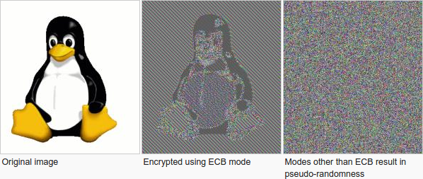
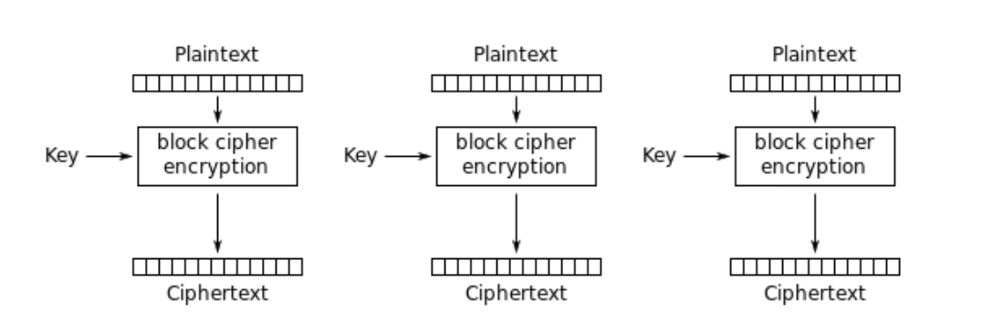
Possible questions
Medium - hard
In what scenario is it safe to use ECB mode?
ECB (Electronic Codebook): Each block is encrypted independently

Slide 49
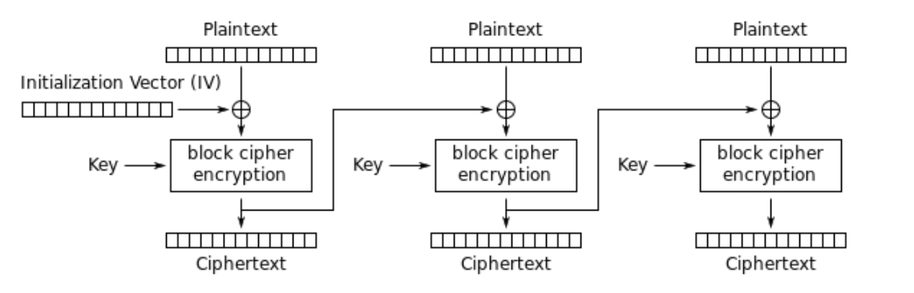
CBC Mode
CBC (Cipher Block Chaining) Each encrypted block is XOR’d with the next block. Start with the IV
AND
OR
XOR
p | k | c
1 | 1 | 1
1 | 0 | 0
0 | 1 | 0
0 | 0 | 0
p | k | c
1 | 1 | 1
1 | 0 | 1
0 | 1 | 1
0 | 0 | 0
p | k | c
1 | 1 | 0
1 | 0 | 1
0 | 1 | 1
0 | 0 | 0

Slide 50
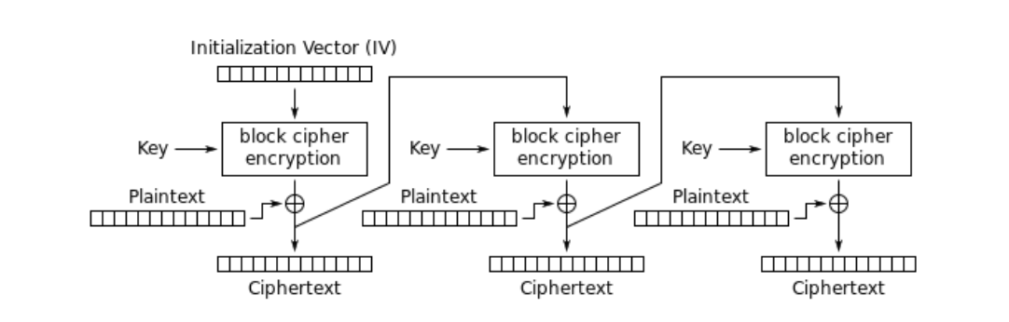
CFB Mode
CFB (Cipher Feedback) Same mechanism as CBC but operates as a stream of real time data

Slide 51
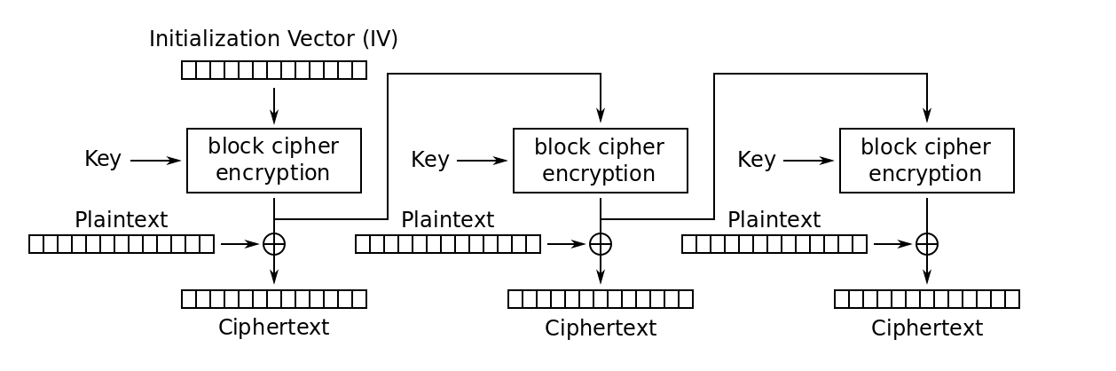
OFB Mode
OFB (Output Feedback) Same as CFB but uses the IV and encrypted versions of the IV as input to successive blocks

Slide 52
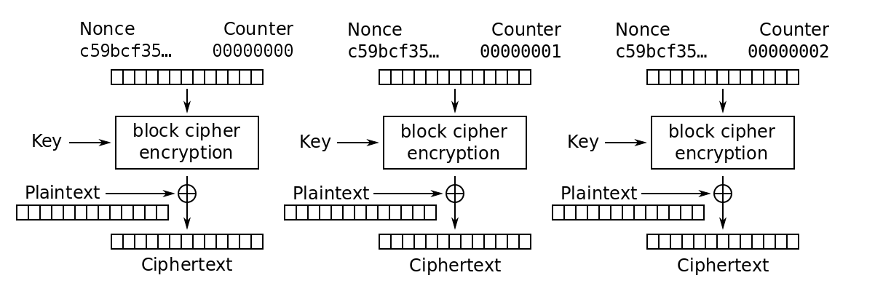
CTR Mode
CTR (Counter) Same as OFB but uses a simple counter to alter seed input to each encryption

Slide 53
Pros and Cons of Modes
CBC and CFB mode propagates errors and this will corrupt attempts to decrypt
OFB does not propagate errors in blocks
ECB and CTR can be parallelized and so are fast

Slide 54
Possible questions
Medium - hard
In what scenario is it safe to use ECB mode?
If the performance isn’t an issue, does n-DES improve security? Why? Any limitations?

Slide 55
Possible questions
Medium - hard
In what scenario is it safe to use ECB mode?
If the performance isn’t an issue, does n-DES improve security? Why? Any limitations?

Slide 56
Possible questions
Medium - hard
In what scenario is it safe to use EBC mode?
If the performance isn’t an issue, does n-DES improve security? Why? Any limitations?
Does adding additional substitution and/or transposition layers in an encryption improve security? Why?

Slide 57
Possible questions
Medium - hard
In what scenario is it safe to use EBC mode?
If the performance isn’t an issue, does n-DES improve security? Why? Any limitations?
Does adding additional substitution and/or transposition layers in an encryption improve security? Why?

Slide 58
An example
plaintext | A
Caesar cipher key | A
ciphertext | B
plaintext | A
Caesar cipher key | A | C (equivalent )
 | B
ciphertext | D | D
Adding an extra substitution layer essentially does not enhance the security.

Slide 59
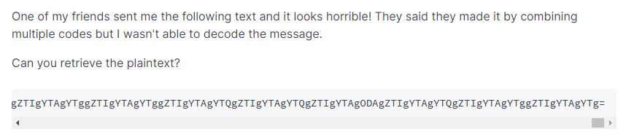
Lab 2
Q5: crypto mess

Slide 60
Lab 2
Hints: 1. figure out the representing code that is used by the text.
What code can generate a text with “=” at the end?
What code can generate a text of numbers 0-10 and letters A-F?
2. figure out the cipher that is used by the text
What cipher can generate a text with only dot symbol?
What cipher can generate a text with only dots and dashes?

